Slide 1
INTRODUCTION TO MARKETING
0
Chapter 3
The Cultural
Environment
NGUYEN THI PHUONG*
THANG LONG UNIVERSITY
*MA in Global Marketing, PHD in Economics

Slide 2
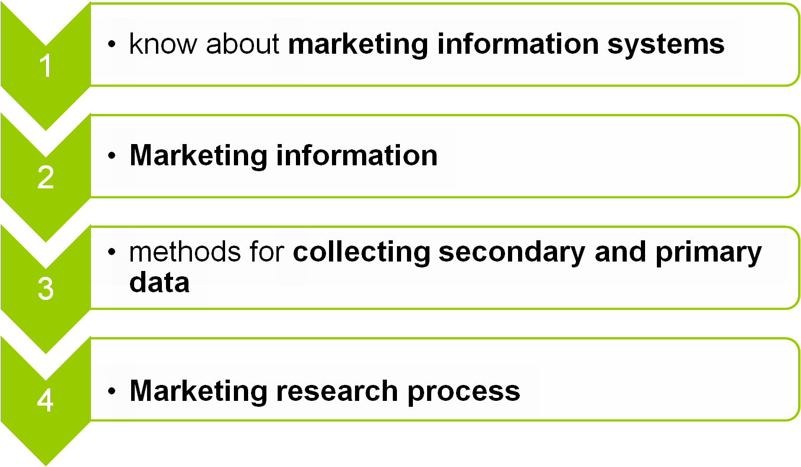
SESSION 4: Marketing information
Copyright © 2011 Pearson Education
15-<number>

Slide 3

To make good marketing decisions, managers need accurate information about what is happening in the market
Copyright © 2011 Pearson Education
15-<number>

Slide 4
Example 1: If you are a foreign car manufacturer and want to invest and produce your car in Vietnam, what kind of information do you need to study?
Example 2: If import car tax in Vietnam drops to 50%, how does this information affect your business?
Copyright © 2011 Pearson Education
15-<number>

Slide 5
Marketing research
Marketing research is procedure that develops and analyzes new information about a market. Marketing research may be involved use of questionnaires, interviews with customers, experiments and many other approaches
Marketing managers get help from a marketing information system (MIS) which is an organized way of gathering, accessing and analyzing information
Copyright © 2011 Pearson Education
15-<number>

Slide 6
4.1 Marketing information systems
Many firms have their own intranet-a system for linking computers within a company. An intranet works like internet. However, to maintain security, access to websites or data on an intranet is usually limited to employees
a continual flow of information that is available and quickly accessible needs MIS
Copyright © 2011 Pearson Education
15-<number>

Slide 7
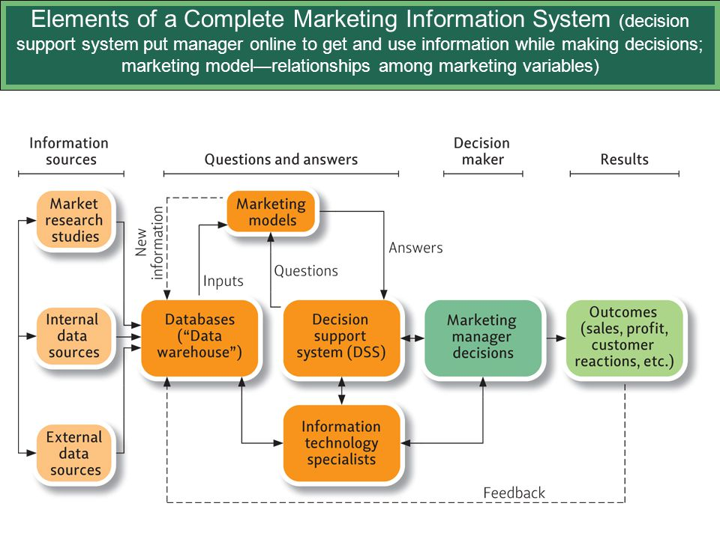
Copyright © 2011 Pearson Education
15-<number>
Notes:
Information sources include market research studies, internal and external data sources. This information is contained in data warehouse. Data warehouse is considered as input of marketing models and marketing model vice versa bring new information to data warehouse. It is two ways directions. Marketing model is used to bring answers to DSS and DSS brings questions to marketing models. Data warehouse also bring info to information technology specialists. DSS and specialist help marketing manager give decisions.

Slide 8
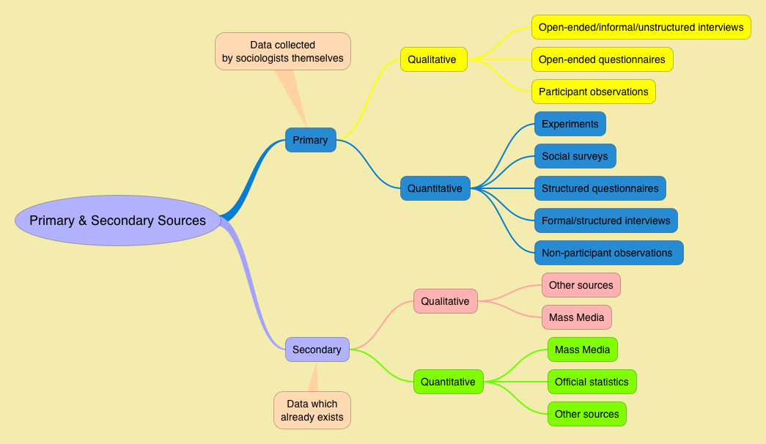
4.2 Marketing information
The information may come from a single source or through a system of collection
Copyright © 2011 Pearson Education
15-<number>

Slide 9
secondary data: information that has been collected or published already.
Secondary data also is available from company’s file and reports, libraries, trade associations, government agencies and private research organizations.
primary data: information must come from own observations and measurements collected
“primary information” involve the collection of both qualitative and quantitative primary information
Copyright © 2011 Pearson Education
15-<number>

Slide 10
Qualitative information: collected though observation or subjective judgment and does not involve measurement. Qualitative research seeks in-depth, open-ended responses.
- Focus groups discussion: involves interviewing 6 to 10 people in an informal group setting
- Personal interview surveys: get better responses
- Observing: collecting data-focuses on a well- defined problem
- Structured Interview, Semi-structured Interview, Unstructured Interview
Copyright © 2011 Pearson Education
15-<number>

Slide 11
Quantitative information: collected through measurement and may be processed using statistical and other techniques. Quantitative research seeks structured responses such as numbers, percentages, averages, or other statistics
- Survey questionnaires: multiple-choice makes it easier and faster for respondents to reply.
Various forms of surveys: online surveys, paper surveys, mobile (telephone) surveys, face-to-face interviews, telephone interviews, longitudinal studies
Copyright © 2011 Pearson Education
15-<number>

Slide 12
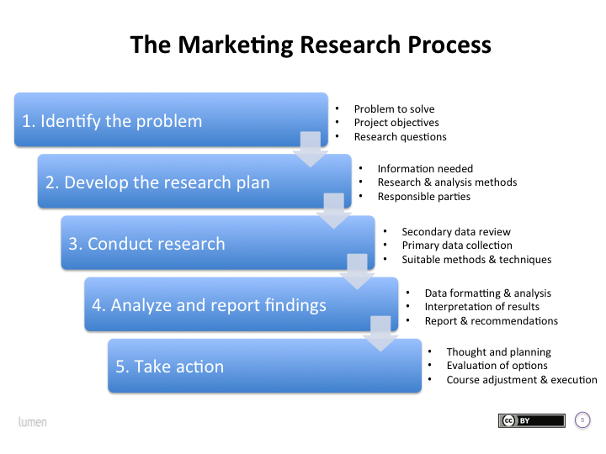
4.3 Marketing research process
Copyright © 2011 Pearson Education
15-<number>

Slide 13
Homework
1. Discuss how output product from a marketing information system (MIS) might different from the output of a typical marketing research department?
2. Distinguish between primary data and secondary data and illustrate your answer
Copyright © 2011 Pearson Education
15-<number>

